Slide 1

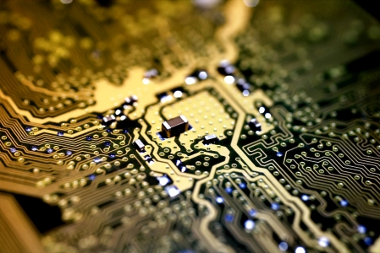
Programming with C++
Chapter 1: Introduction
Bujar Mamudi
Yahya Kemal College
Spring 2012

Slide 2

Osman AY Muhammed Akif HORASANLI
Text Book

Slide 3
Contents:
Understanding programming
Basic input/output
Operators
Variables
ASCII Code
Using Text Files

Slide 4
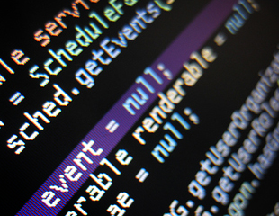

Understanding Programming

Slide 5
Understanding programming
Programming is telling the computer to perform a task for you with the help of a programming language.
An algorithm is a step by step solution to a task.
Programmers vs. Users

Slide 6
Understanding programming
A computer program (software) contains a sequence of instructions for a computer.
Consists of three parts:
Input part gets the data from an input device.
Process part executes the algorithm and finds out the desired result.
Output part shows the result of the program.

Slide 7
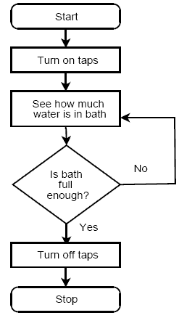
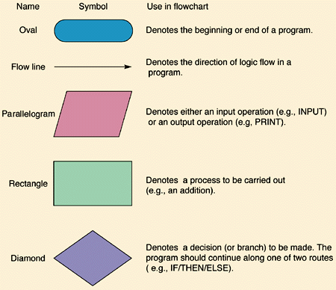
Flowchart
A flowchart is a visual representation of the algorithms. It is made up of a few symbols:

Slide 8
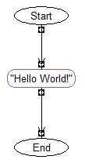

“Hello World!” – First C++ Program
#include<iostream>
using namespace std;
int main()
{
cout<<"Hello World!";
system("pause");
return 0;
}

Slide 9
/*
PROG: Hello_World.cpp
DESCRIPTION: Understanding the structure of C++ program.
Printing a line of text.
Using comments.
*/
#include<iostream>
// includes the declarations of the basic standard input-output
// library in C++, and its functionality is going to be used later
// in the program.
using namespace std;
// Namespaces are containers that contain the declarations of all
// the elements of the standard C++ library
int main() // the only function in this program.
{
cout<<"Hello World!"; // print "Hello World!"
// cout is declared in the iostream
// file within the std namespace
system("pause"); // stop and wait until user hits a button
return 0; // the main function ends properly
}

Slide 10
Understanding programming
C++ programs consist of one or more modules. Each module performs a specific task. These modules are called functions.
Every C++ program starts to execute from the main() function so each program must have this function.

Slide 11
Understanding programming
The #include and the using namespace parts declare the libraries where the C++ commands are defined.
Each C++ statement ends with a semicolon character (“ ; ”).
Example: cout<<"Hello World!";
system("pause");

Slide 12
Comments
Include comments in your programs to describe, document, and make the code easy to read.
Single line comments are written behind the double slash characters (“ // “) and multiple line comments are enclosed between slash and asterisk (“ /* “) and asterisk and slash (“ */ ”) characters.
Example: // This is a single line comment
/*
This is a multiple line comment.
*/

Slide 13
Breaking text into multiple lines
Use end of line “endl” or new line ‘\n’ characters within a cout statement to make a new line.
Example:
cout<<"Hello "<<endl;
cout <<"Hello \n";

Slide 14
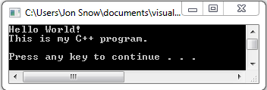
Hello World 2
/*
PROG: Hello_World2.cpp
DESCRIPTION: Using endl.
*/
#include<iostream>
using namespace std;
int main()
{
cout<<"Hello World! \n"; // move the cursor to the beginning
// of the next line
cout<<"This is my C++ program."<<endl<<endl;
system("pause");
return 0;
}

Slide 15
Basic Arithmetic
Any statement enclosed with double quotes (“ “) in a cout statement is displayed directly.
Any arithmetical or logical expression is evaluated and then the result is displayed.

Slide 16
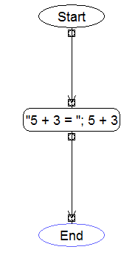

Sum
/*
PROG: Sum.cpp
*/
#include<iostream>
using namespace std;
int main()
{
// calculate and print the sum
cout<<"5 + 3 = "<< 5 + 3 <<endl;
system("pause");
return 0;
}

Slide 17
Basic Input/Output

Slide 18
Getting input data from user
The “cin” command is used to read data from the standard input (keyboard or file).
cin>> num1;
A variable is a named storage location that can contain data that can be modified during program execution.
Example: int num1, num2, sum;

Slide 19
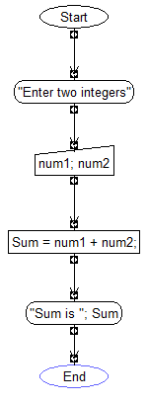
Problem 1:
Write a C++ program that reads two integers, calculates their sum and then outputs the result.

Slide 20
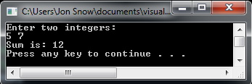
/*
PROG: Sum.cpp
*/
#include<iostream>
using namespace std;
int main()
{
// num1, num2, and sum are three
// variables of type integer
int num1, num2, sum;
cout<<"Enter two integers: "<<endl;
cin>> num1 >> num2;
// cin reads two values for num1 and num2.
// sum gets the value of num1 + num2;
sum = num1 + num2;
cout<<"Sum is: "<<sum<<endl;
system("PAUSE");
return 0;
}

Slide 21
Sum of two integers
sum = num1 + num2; first computes the value of num1 + num2 and then assigns the result to the variable sum.
The statement sum = num1 + num2;
is formed with the arithmetic operator (+)
and the assignment operator (=).

Slide 22
Arithmetic Operators

Slide 23

Arithmetic Operators
Operation | Operator | Example
Addition | + | 5 + 4
Subtraction | - | 5 - 4
Multiplication | * | 5 * 4
Division (integer) | / | 15 / 3
Modulus | % | 5 % 4
Modulus: $a ≡b \left( mod n\right)$ if $a −b$ is an integer multiple of $n$
Example: 10 $\%$ 4 = 2 (mod 4) 10 – 2 = 8 and 8 is a multiple of 4
11 $\%$ 4 = 3 (mod 4) 11 – 3 = 8 and 8 is a multiple of 4
12 $\%$ 4 = 0 (mod 4) 12 – 0 = 12 and 12 is a multiple of 4
13 $\%$ 4 = __ (mod 4)
14 $\%$ 4 = __ (mod 4)
5 $\% 4$= __ (mod 4)

Slide 24
Assignment Operator
Operator | Meaning | Example
= | Store the value of the second variable in the memory specified by the first variable. | num1 = num2;
Example:
int num1, num2;
num2 = 5;
num1 = num2;
cout<<num1<<endl;

Slide 25
Increment Operator
Operator | Meaning | Example
++ | Increase the value of the variable by 1; | num1++;
Example:
int num1;
num1 = 5;
// num1 = num1 + 1; i can write the same in a shorter way
// num1 += 1; i can write it even shorter
num1++;
cout<<num1<<endl;

Slide 26
Decrement Operator
Operator | Meaning | Example
-- | Decrease the value of the variable by 1; | num1--;
Example:
int num1;
num1 = 5;
// num1 = num1 - 1; i can write the same in a shorter way
// num1 -= 1; i can write it even shorter
num1--;
cout<<num1<<endl;

Slide 27
Compound Sum Operators
Operator | Meaning | Example
+= | Add the value of the second variable to the value of the first variable; store the result in the memory specified by the first variable. | sum += num1;
Example:
int sum, num1;
num1 = 5;
sum = 10;
// sum = sum + num1; i can write the same in a shorter way
sum += num1;
cout<<sum<<endl;

Slide 28
Compound Difference Operators
Operator | Meaning | Example
-= | Subtract the value of the second variable to the value of the first variable; store the result in the memory specified by the first variable. | diff -= num1;
Example:
int diff, num1;
num1 = 5;
diff = 10;
// diff = diff - num1; i can write the same in a shorter way
diff -= num1;
cout<<diff<<endl;

Slide 29
Compound Product Operators
Operator | Meaning | Example
*= | Multiply the value of the first variable by the value of the second variable; store the result in the memory specified by the first variable. | prod *= num1;
Example:
int prod, num1;
num1 = 5;
prod = 10;
// prod = prod * num1; i can write the same in a shorter way
prod *= num1;
cout<<prod<<endl;

Slide 30
Compound Quotient Operators
Operator | Meaning | Example
/= | Divide the value of the first variable by the value of the second variable; store the result in the memory specified by the first variable. | quot /= num1;
Example:
int quot, num1;
num1 = 5;
quot = 10;
// quot = quot / num1; i can write the same in a shorter way
quot /= num1;
cout<<quot<<endl;

Slide 31
Compound Modulus Operators
Operator | Meaning | Example
%= | Take modulus of the first variable specified by the value of the second variable; store the result in the memory specified by the first variable. | mod %= num1;
Example:
int mod, num1;
num1 = 4;
mod = 7;
// mod = mod % num1; i can write the same in a shorter way
mod %= num1;
cout<<mod<<endl;

Slide 32
Bitwise Shift-Right Operator
Operator | Meaning | Example
>>= | Shift the value of the first variable right the number of bits specified by the value of the second variable; store the result in the memory specified by the first variable. | shiftRight >>=num1;
Example:
int num1, shiftRight;
num1 = 2;
shiftRight = 23;
// shiftRight = shiftRight >> num1;
// 23 in binary is 0001 0111 we shift 2 times from right side and
// the result is 0000 0101 in decimal system is 5
shiftRight >>= num1;
cout<<shiftRight<<endl;

Slide 33
Bitwise Shift-Left Operator
Operator | Meaning | Example
<<= | Shift the value of the first variable left the number of bits specified by the value of the second variable; store the result in the memory specified by the first variable. | shiftLeft <<= num1;
Example:
int num1, shiftLeft;
num1 = 2;
shiftLeft = 23;
// shiftLeft = shiftLeft << num1;
// 23 in binary is 0001 0111 we shift 2 times from left side and
// the result is 0101 1100 in decimal system is 92
shiftLeft <<= num1;
cout<<shiftLeft<<endl;

Slide 34
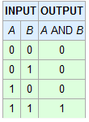
Bitwise AND Logical Operator
Operator | Meaning | Example
&= | Obtain the bitwise AND of the first and second variables; store the result in the memory specified by the first variable. | bitAnd &= num1;
Example:
int num1, bitAnd;
num1 = 25;
bitAnd = 19;
// bitAnd = bitAnd & num1;
// 19 in binary is 0001 0011
// 25 in binary is 0001 1001 we aply the logical AND operation we get
// 0001 0001 which in decimal system is 17
bitAnd &= num1;
cout<<bitAnd<<endl;

Slide 35
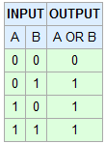
Bitwise OR Logical Operator
Operator | Meaning | Example
|= | Obtain the bitwise Inclusive OR of the first and second variables; store the result in the memory specified by the first variable. | bitOr |= num1;
Example:
int num1, bitOr;
num1 = 25;
bitOr = 19;
// bitOr = bitOr | num1;
// 19 in binary is 0001 0011
// 25 in binary is 0001 1001 we aply the logical OR operation we get
// 0001 1011 which in decimal system is 27
bitOr |= num1;
cout<<bitOr<<endl;

Slide 36

Bitwise XOR Logical Operator
Operator | Meaning | Example
^= | Obtain the bitwise Exclusive OR of the first and second variables; store the result in the memory specified by the first variable. | bitXor ^= num1;
Example:
int num1, bitXor;
num1 = 25;
bitXor = 19;
// bitOr = bitXor ^ num1;
// 19 in binary is 0001 0011
// 25 in binary is 0001 1001 we aply the logical XOR operation we get
// 0000 1010 which in decimal system is 10
bitXor ^= num1;
cout<<bitXor<<endl;

Slide 37
Problem 2:
Write a C++ program that reads two integers and then calculates their sum, their difference, their product, their quotient (float casting), their remainder(modulus).

Slide 38
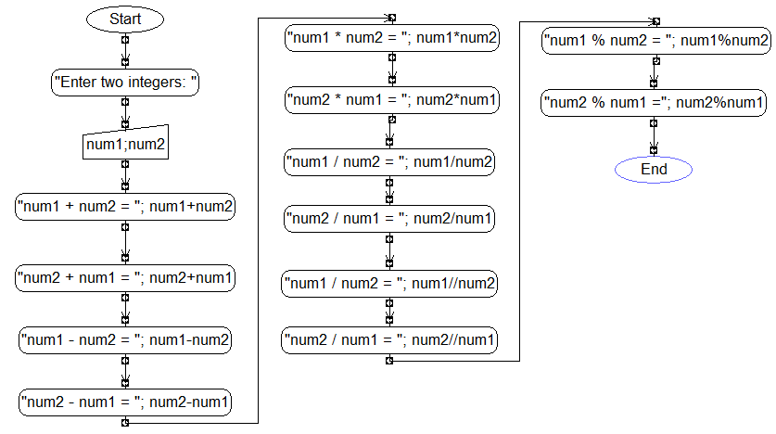
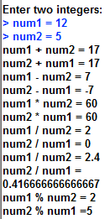
Flowchart

Slide 39
/*
PROG: Arithmetic.cpp
DESCRIPTION: Demonstrating arithmetic operators.
*/
#include<iostream>
using namespace std;
int main()
{
// declare two variables
int num1, num2;
// get input from user
cout<<"Enter the two integers: ";
cin>> num1 >> num2;
// calculate sum
cout<<endl<<num1<<"+"<<num2<<"="<<num1 + num2<<endl;
cout<<num2<<"+"<<num1<<"="<<num2 + num1<<endl<<endl;
// calculate difference
cout<<num1<<"-"<<num2<<"="<<num1 - num2<<endl;
cout<<num2<<"-"<<num1<<"="<<num2 - num1<<endl<<endl;

Slide 40
// calculate product
cout<<num1<<"*"<<num2<<"="<<num1 * num2<<endl;
cout<<num2<<"*"<<num1<<"="<<num2 * num1<<endl<<endl;
// calculate quotient as integer and then as float type
cout<<"integer: "<<num1<<"/"<<num2<<"="<<num1 / num2<<endl;
cout<<"float: "<<num1<<"/"<<num2<<"="<<(float)num1 / num2<<endl;
cout<<"integer: "<<num2<<"/"<<num1<<"="<<num2 / num1<<endl;
cout<<"float: "<<num2<<"/"<<num1<<"="<<(float)num2 / num1<<endl<<endl;
// calculate modulus
cout<<num1<<"%"<<num2<<"="<<num1 % num2<<endl;
cout<<num2<<"%"<<num1<<"="<<num2 % num1<<endl<<endl;
system("PAUSE");
return 0;
}

Slide 41
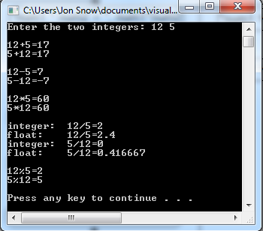

Slide 42
Precedence of Arithmetic Operators
Parenthesis “( )” are evaluated first.
If parenthesis are nested the expression in the innermost parenthesis is evaluated first.
( 2 * (2 + 4 – ( 8 /2)))
After parenthesis, multiplication (*), division(/), and modulus (%) operators are evaluated.
Addition (+) and subtraction (-) are evaluated last.
The operators with same precedence are evaluated from left to right.

Slide 43
Precedence of Arithmetic Operators
3 * 5 + 2 = 17
3 * (5 + 2) = 21
5 + 3 * 4 – 2 = 15
6 * 8 / 4 = 12
6 * ( 8 / 4) = 12

Slide 44
Exercise: Rectangle
Write a C++ program to calculate the area and perimeter of a rectangle.
Perimeter = 2 * ( length + width)
Area = length * width
width
length

Slide 45
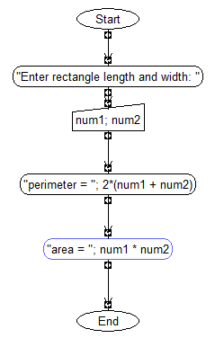
Exercise: Rectangle

Slide 46
/*
PROG: Rectangle.cpp
DESCRIPTION: Find the perimeter and area of a rectangle.
*/
#include<iostream>
using namespace std;
int main()
{
// declare variables
int length, width, perimeter, area;
// get user input
cout<<"Enter rectangle length: ";
cin>> length;
cout<<"Enter rectangle width: ";
cin>> width;
// calculate and show perimeter and area
perimeter = 2 * ( length + width );
cout<<"\nPerimeter = "<<"2 * ("<< length << " + " << width << ") = “ <<perimeter<<endl;
area = length * width;
cout<<"Area = "<< length << " * " << width << "= "<<area<<endl;
system("PAUSE");
return 0;
}

Slide 47
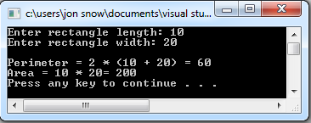
Exercise: Rectangle

Slide 48
Variables

Slide 49
Variables
A variable is a memory place in which you can store a value and from which you can later retrieve that value.
This temporary memory storage is used only during the execution of the program.

Slide 50
Fundamental C++ Variables
Integer variables store whole numbers ( -4, 3, 51, etc.)
Unsigned integer variables cannot have negative values
Floating-point variables store decimal numbers (3.5, -4.0)
Logical variables represent 1 as true and 0 as false
Character variables store characters ( letters, numbers, punctuation characters). Characters are enclosed with a pair of single quotes. Example: ‘a’, ‘B’, ‘7’, ‘+’

Slide 51
Fundamental C++ Variables
 | Type | Bytes | Values
Integer variables | unsigned short int | 2 | 0 to 2¹⁶ -1
 | short int | 2 | - 2¹⁵ to 2¹⁵ -1
 | unsigned int | 4 | 0 to 2³² -1
 | int | 4 | - 2³¹ to 2³¹ -1
 | unsigned long int | 4 | 0 to 2³² -1
 | long int | 4 | - 2³¹ to 2³¹ -1
 | long long int | 8 | - 2⁶³ to 2⁶³ -1
floating – point variables | float | 4 | (~7 digits)
 | double | 8 | (~15 digits)
logical variables | bool | 1 | true or false
character variables | char | 1 | 2⁸ character values

Slide 52
Sizes of variables
The actual size of variables might be different from those shown in the table depending on what computer(compiler) you are using.
You can use sizeof() operator to measure how many bytes are the variable types in your system.

Slide 53
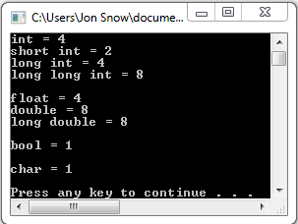
/*
PROG: SizeOf.cpp
C++ variable types and their sizes in bytes.
*/
#include<iostream>
using namespace std;
int main()
{
cout<<"int = "<<sizeof(int)<<endl;
cout<<"short int = "<<sizeof(short int)<<endl;
cout<<"long int = "<<sizeof(long int)<<endl;
cout<<"long long int = "<<sizeof(long long int)<<endl<<endl;
cout<<"float = "<<sizeof(float)<<endl;
cout<<"double = "<<sizeof(double)<<endl;
cout<<"long double = "<<sizeof(long double)<<endl<<endl;
cout<<"bool = "<<sizeof(bool)<<endl<<endl;
cout<<"char = "<<sizeof(char)<<endl<<endl;
system("PAUSE");
return 0;
}

Slide 54
Constants
Constants are data storage locations but their value does not change.
You must initialize a constant when you first create it, and you cannot assign a new value later.
#include<iostream>
#define PI 3.14; // define PI as a constant
…
int main()
{
const float PI = 3.14; // define PI as a constant
…

Slide 55
Exercise: Circle
Write a C++ program to calculate the area and circumference of a circle. Make use of the M_PI arithmetic constant defined in the library cmath.
Circumference = 2 * PI * Radius
Area = PI * Radius * Radius
radius

Slide 56
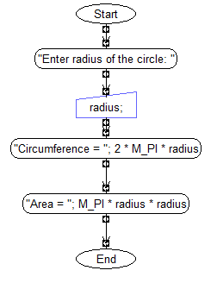
Exercise: Circle

Slide 57
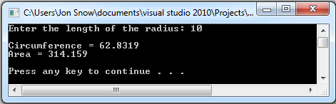
/*
PROG: Circle.cpp
DESCRIPTION: Use constant M_PI as declared from the cmath library.
*/
#define _USE_MATH_DEFINES
#include<cmath> // include the cmath library
#include<iostream>
using namespace std;
int main()
{
// declare variables
float radius, circumference, area;
// get radius from user
cout<<"Enter the length of the radius: ";
cin>> radius;
// calculate and show circumference
circumference = 2 * M_PI * radius;
cout<<"\nCircumference = "<<circumference<<endl;
//calculate and show area
area = M_PI * radius * radius;
cout<<"Area = "<<area<<endl<<endl;
system("PAUSE");
return 0;
}

Slide 58
Exercise: 1 or 0
Write a C++ program that gets two numbers and displays 1 if first is bigger than second, otherwise displays 0.

Slide 59
/*
PROG: Bool.cpp
DESCRIPTION: Compare if first is bigger than second
*/
#include<iostream>
using namespace std;
int main()
{
float num1, num2;
// get user input
cout<<"Enter the firs number: ";
cin>> num1;
cout<<"Enter second number: ";
cin>> num2;
// compare if first is greater
cout<<endl<< (num1 > num2)<<endl<<endl;
system("PAUSE");
return 0;
}

Slide 60
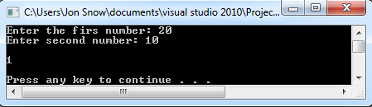
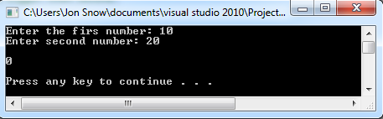

Slide 61
ASCII Code

Slide 62

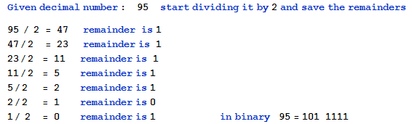
Decimal vs Binary
Computers work with binary numbers ( 0 and 1).
We already know how to convert binary to decimal?
and also convert decimal to binary?

Slide 63
ASCII
Character encoding (character set) tables are used to represent characters with numbers.
ASCII (1963) and EBCDIC (1964) are two international standard character sets.
ASCII acronym means American Standard Code for Information Interchange.
In ASCII every letter, number, and punctuation symbol has a corresponding number (ASCII code).

Slide 64
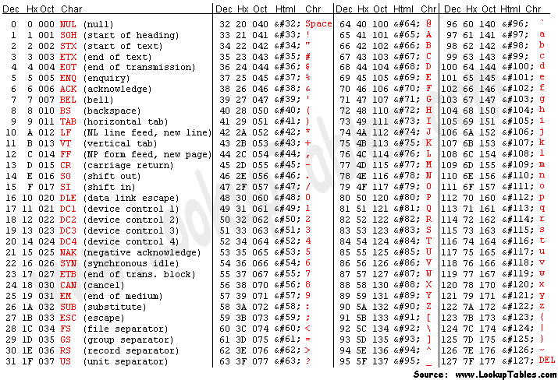
Standard ASCII Code

Slide 65
ASCII
In an ASCII file, each alphabetic, numeric, or special character is represented with a 7-bit binary number ( a string of seven 0’s and 1’s).
128 possible characters are defined in total.
There are also ASCII extensions which utilize 8 bits to represent international characters in addition to the standard ASCII scheme.

Slide 66
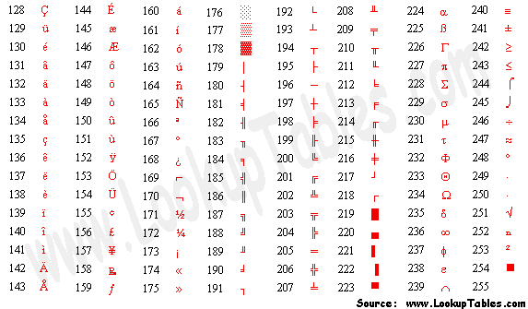
Extended ASCII Codes

Slide 67
Exercise: ASCII code to Character
Write a C++ program that given the ASCII code from 0 – 127 will show the corresponding character. Make use of the (char) casting.

Slide 68
/*
PROG: ASCIItoChar.cpp
DESCRIPTION: Convert ASCII Code to corresponding Character.
*/
#include<iostream>
using namespace std;
int main()
{
int code;
// get code from user
cout<<"Enter the ASCII code [0 - 127]: ";
cin>> code;
// use (char) casting to convert and show character
cout<<"\nThe corresponding character from the ASCII code “
<<code<<" is: "<<(char)code<<endl<<endl;
system("PAUSE");
return 0;
}

Slide 69
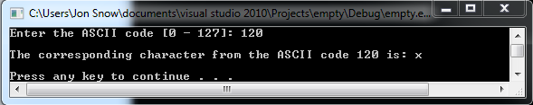

Exercise: ASCII code to Character

Slide 70
Exercise: Character to ASCII Code
Write a C++ program that given a character it will show the corresponding ASCII Code. Make use of the (int) casting.

Slide 71
/*
PROG: CharToASCII.cpp
DESCRIPTION: Convert character to ASCII code.
*/
#include<iostream>
using namespace std;
int main()
{
char character;
// get character from user
cout<<"Enter a single character: ";
cin>> character;
// use (int) casting to convert character and show code
cout<<"\nThe corresponding ASCII code for the character “ <<character<<" is: "<<(int)character<<endl<<endl;
system("PAUSE");
return 0;
}

Slide 72
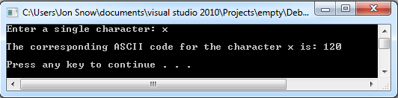
Exercise: ASCII code to Character

Slide 73
Strings

Slide 74
String
In programing a string is an ordered series of characters.
You can consider strings as words and sentences.
Strings are enclosed in double quotes
“Hello Wolrd!”
“I am learning C++.”
C++ provides a string class defined in the <string> standard library.
#include<string>

Slide 75
Reading and Printing Strings
cin reads only the first word of a string
cout prints all characters of a string
We can join two strings objects by placing the concatenation operator (+) between them.
57 + 33 becomes 90
“57” + “33” becomes “5733”
“Yahya” + “Kemal” becomes “YahyaKemal”

Slide 76
Exercise: Hello Message
Write a C++ program that gets the name and surname of the user, and then prints a hello message. Make use of strings.

Slide 77
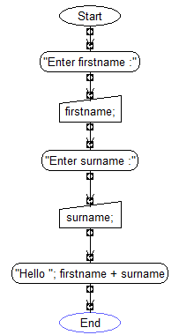
Exercise: Hello Message

Slide 78
/*
PROG: HelloMessage.cpp
DESCRIPTION: Get name from user and display message.
Use string concatenation operator (+).
*/
#include<iostream>
#include<string>
using namespace std;
int main()
{
// declare strings
string firstName, surName;
string bye = "Have a nice day!\n\n";
// get name from user
cout<<"Enter your first name: ";
cin>> firstName;
cout<<"Enter your surname: ";
cin>>surName;
// show message by using concatenation operator
cout<<"\n\nHello "<<firstName + " " + surName + "."<<endl;
cout<<bye;
system("PAUSE");
return 0;
}

Slide 79
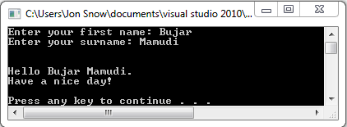
Exercise: Hello Message

Slide 80
Initialization of Variables

Slide 81
Initialization of Variables
You can give the initial values to the variables during their declaration.
int num1 = 5;
float num2= 0.3;
char letter1 = 'x';
bool boolean1 = true;
string str1 = "C++";
string str2("Hello there!");

Slide 82
/*
PROG: Initialization.cpp
DESCRIPTION: Initialization of Variables
*/
#include<iostream>
#include<string>
using namespace std;
int main()
{
string st1("I am learning ");
// st1 is being initialized to "I am learning"
string st2 = "C++";
// st2 is being initialized to "C++"
int num1 = 8, num2 = 5;
// num1 is being initialized to 8, num2 to 5
float dec1 = 7.5, dec2 = 3.9;
// dec1 is being initialized to 7.5, dec 2 to 3.9
char ch1 = 'A';
// ch1 is being initialized to 'A'
bool bl1 = true, bl2 = false;
// bl1 is being initialized to true, bl2 is being initialized to false
cout<<"st1 + st2 is: "<<st1 + st2<<endl;
cout<<"num1 + num2 is: "<<num1 + num2<<endl;
cout<<"dec1 + dec2 is: "<<dec1 + dec2<<endl;
cout<<"ch1 is: "<<ch1<<endl;
cout<<"bl1 is: "<<bl1<<endl;
cout<<"bl2 is: "<<bl2<<endl<<endl;
system("PAUSE"); return 0;
}

Slide 83
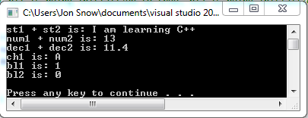
Initialization

Slide 84
Using Text Files

Slide 85
Read and write from Text Files
C++ provides two functions to read or write from a text file.
ifstream() opens an existing input file
ofstream() creates and opens an output file
Both functions are declared in the <fstream> header.
#include<fstream>
fin identifier takes the role of cin
fout identifier takes the role of cout
After you have finished with the text file, you should close them with the close() function.

Slide 86
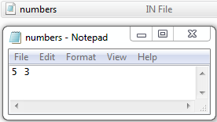
Exercise: ReadWrite from Text File
Write a C++ program that reads two integers (num1 and num2) from the file numbers.in
Compute their sum, difference, product, quotient for those two numbers and write the result in the text file numbers.out

Slide 87
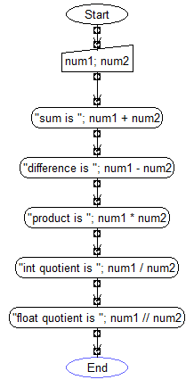
Exercise: ReadWrite from Text File

Slide 88
/* PROG: ReadWriteFromTextFile.cpp
DESCRIPTION: Using input and output files.
NOTE: text file numbers.in must already exist in the project folder!
*/
#include<fstream>
using namespace std;
int main()
{
ifstream fin("numbers.in"); //open input file
ofstream fout("number.out"); //create and open output file
int num1, num2;
fin>>num1 >>num2; //read two integers from input file
//Make calculations and write results in output file
fout<<"sum is: "<<num1 + num2<<endl;
fout<<"difference is: "<<num1 - num2<<endl;
fout<<"product is: "<<num1 * num2<<endl;
fout<<"integer quotient is: "<<num1/num2<<endl;
fout<<"float quotient is: "<<(float)num1/num2<<endl;
fin.close(); // close the input file
fout.close(); //close the output file
system("PAUSE"); return 0;
}

Slide 89
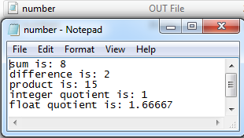
Exercise: ReadWrite from Text File

Slide 90
Summary

Slide 91
Summary
An algorithm is a set of ordered steps for solving a particular problem.
A computer program is series of instructions or statements, in a form acceptable to a computer, to carry out an algorithm.
A programming language is a human-created language that translates instructions from programmers to computers.

Slide 92
Summary
C++ is an object-oriented programming (OOP) language and the primary programming language for computers of today.
Any C++ program consists of modules that are called functions.
The primary function of a C++ program is main()
C++ uses cout and cin for printing and getting the data.

Slide 93
Summary
Operators are symbols (such as +, *, /) used to perform arithmetic, relational, logical, assignment, string, bitwise etc. operations.
A variable is a named item used to represent data that can be changed while the program is running.
Like a variable, a constant is named item but it has a fixed value that does not change.

Slide 94
Summary
ASCII (American Standard Code of Information Interchange) is an international code standard for representation of characters, numbers, symbols and control characters, for use in data communication and data storage.
ASCII text does not include special formatting features and therefore can be exchanged and read by most computer systems.

Slide 95
Summary
A string is a series of alphanumeric characters of any length. Strings are enclosed by double quotes in C++.
File processing consists of creating a file, storing data into a file, and retrieving data from a file.
C++ performs file processing with ifstream() and ofstream() functions that are defined in the <sting> header file.

Slide 96
Review Questions

Slide 97

Review Questions
What is the output of the following program?
#include<iostream>
using namespace std;
int main()
{
cout<<"I am ";
cout<<"learning "<<endl<<"C++";
return 0;
}

Slide 98

Review Questions
What is the output of the following program?
#include<iostream>
using namespace std;
int main()
{
int a = 1, b = 2;
cout << a << " " << b;
a = a + b;
b = a + b;
cout << b << " " << a;
return 0;
}

Slide 99
Review Questions
Calculate the values of variables in the given lines:
#include<iostream>
using namespace std;
int main()
{
int a = 1, b = 2, c = 3;
a = b + c; b = a - b * c;
c = (a + c) / (c - b); a = a % b / c; b = -b;
system("PAUSE");
return 0;
}
Line | a | b | c
1 | 1 | 2 | 3
2 | 2 + 3 = 5 | 5 – 2 * 3 = 5 - 6= -1 | 3
3 | 5 % (-1) / 2 = = 0 /2 = 0 | -(-1) = +1 | (5 + 3) /(3 - (-1)) = = 8 /4 = 2

Slide 100
Review Questions
What is the suitable variable type for the given data?
Data | Variable Type
Age of a person | unsigned short int
Name of a person | string
Gender of a person (‘F’ or ‘M’) | char
State of electricity switch (ON or OFF) | bool
Number of the passengers in an airplane | unsigned short int
Area of a circle (max precision) | long double
Temperature | int

Slide 101
Programming Problems

Slide 102
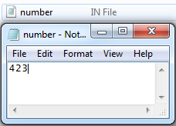
Sum of digits
Write a C++ program that reads a three-digit integer from the file “number.in” and then calculates sum of the digits and writes the result into a file “sum.out”.
(Hint: use modulus (%) and integer division (/) operators.)
NOTE: the text file “number.in” must exist in project folder.

Slide 103
#include<fstream>
using namespace std;
int main()
{
ifstream fin("number.in"); //open input file
ofstream fout("sum.out"); // create and open output file
int input;
fin>> input; //read number from file
int firstDigit, secondDigit, thirdDigit;
// integer division with 100 will leave only first digit
firstDigit = input /100;
// subtract the number with 100 * first digit to eliminate first digit
// you are left with two digits, to save the second,integer divide with 10
secondDigit = (input - (100 * (input / 100)))/10;
// modulus with 10 will leave only the last digit
thirdDigit = input % 10;
fout<<firstDigit<<" "<<secondDigit<<" "<<thirdDigit<<endl;
fout<<"Sum of digits is: "<<firstDigit<<" + "<<secondDigit<<" + “ <<thirdDigit<<" = "<<firstDigit + secondDigit +thirdDigit<<endl;
fin.close(); //close input file
fout.close(); //close output file
system("PAUSE"); return 0;
}

Slide 104
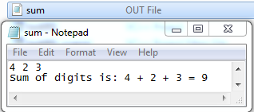
Sum of digits

Slide 105
Swapping
You are given two integer variables, lets say a and b. How can you interchange the values of those two variables?
a) use a temporary third variable
b) do not use a temporary third variable
c) use the function swap (a, b);

Slide 106
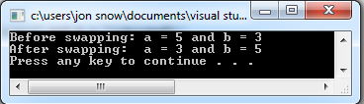
#include<iostream>
using namespace std;
int main()
{
// given integers
int a = 5, b = 3;
// show values
cout<<"Before swapping: a = "<<a<<" and b = "<<b<<endl;
// use a temporary variable
int temp;
temp = a;
a = b;
b = temp;
// show values
cout<<"After swapping: a = "<<a<<" and b = "<<b<<endl;
system("PAUSE");
return 0;
}

Slide 107
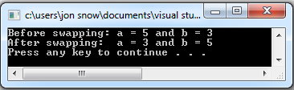
#include<iostream>
using namespace std;
int main()
{
// given integers
int a = 5, b = 3;
// show values
cout<<"Before swapping: a = "<<a<<" and b = "<<b<<endl;
// without a temporary variable
a = a + b; // a = 5 + 3 = 8
b = a - b; // b = 8 - 3 = 5
a = a - b; // a = 8 - 5 = 3
// show values
cout<<"After swapping: a = "<<a<<" and b = "<<b<<endl;
system("PAUSE");
return 0;
}

Slide 108
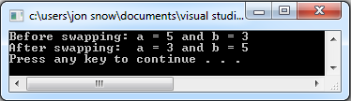
#include<iostream>
using namespace std;
int main()
{
// given integers
int a = 5, b = 3;
// show values
cout<<"Before swapping: a = "<<a<<" and b = "<<b<<endl;
// use the swap() function
swap(a,b);
// show values
cout<<"After swapping: a = "<<a<<" and b = "<<b<<endl;
system("PAUSE");
return 0;
}

Slide 109
To Upper
Write a C++ program that reads a letter from the keyboard and converts the letter to upper case, if the letter is lower case.
a) change the ASCII code of the letter
b) Use the function ( a = toupper(a);)

Slide 110
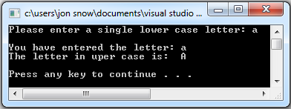
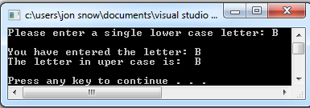
#include<iostream>
using namespace std;
int main()
{
char letter;
cout<<"Please enter a single lower case letter: ";
cin>> letter;
cout<<"\nYou have entered the letter: "<<letter<<endl;
// get ASCII code for letter with integer casting
int code;
code = (int) letter;
//check if lower case
if (code > 96)
{ letter = char(code - 32); }
else
{ letter = char(code); }
cout<<"The letter in upper case is: "<<letter<<endl<<endl;
system("PAUSE"); return 0;
}

Slide 111
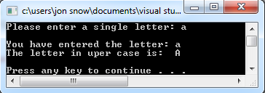
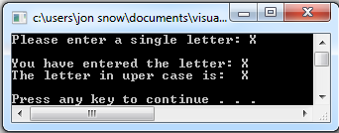
#include<iostream>
using namespace std;
int main()
{
char letter;
// get letter from user
cout<<"Please enter a single letter: ";
cin>> letter;
// show letter
cout<<"\nYou have entered the letter: "<<letter<<endl;
// convert to upper case
letter = toupper(letter);
// show letter
cout<<"The letter in uper case is: "<<letter<<endl<<endl;
system("PAUSE");
return 0;
}

Slide 112
Programming with C++
?
?
?
?
?
Questions?
?
?
?
?
?
© 2012 Bujar Mamudi

